Slide 1
CSM 357
Human-Computer Interaction lecture 3: Interaction models in Human-Computer Interaction
Rose-Mary Owusuaa Mensah Gyening(PhD)

Slide 2
Human Computer Interaction
In this section, we will consider the communication between user and system: the interaction.
We will look at some models of interaction that enable us to identify and evaluate components of the interaction, and at the physical, social and organizational issues

Slide 3
Models
the usefulness of models to help us to understand complex behavior and complex systems.

Slide 4
Interaction
Interaction involves at least two participants: the user and the system.
Both are complex, and are very different from each other in the way that they communicate and view the domain and the task.
The interface must therefore effectively translate between them to allow the interaction to be successful.

Slide 5
Interaction
This translation can fail at a number of points and for a number of reasons.
The use of models of interaction can:
  help us to understand exactly what is going on in the interaction and identify the likely root of difficulties.
  They also provide us with a framework to compare different interaction styles and to consider interaction problems.
  eg. of interaction styles: command line, menus, form filling, question and answer

Slide 6
Interaction models
We begin by considering the most influential model of interaction, Norman’s execution–evaluation cycle; then we look at another model which extends the ideas of Norman’s cycle.
Both of these models describe the interaction in terms of the goals and actions of the user
Traditionally, the purpose of an interactive system is to aid a user in accomplishing goals from some application domain.
A domain defines an area of expertise and knowledge in some real-world activity.

Slide 7
The execution–evaluation cycle
Norman’s model of interaction is perhaps the most influential in Human–Computer Interaction, possibly because of its closeness to our intuitive understanding of the interaction between human user and computer.
  The user formulates a plan of action, which is then executed at the computer interface.
  When the plan, or part of the plan, has been executed, the user observes the computer interface to evaluate the result of the executed plan, and to determine further actions.

Slide 8
Norman’s model of interaction: The execution–evaluation cycle
The Norman’s model interactive cycle can be divided into two major phases: execution and evaluation. These can then be subdivided into further stages, seven in all.
The stages in Norman’s model of interaction are as follows:

Slide 9
Stages in Norman’s model of interaction
1. Establishing the goal.
2. Forming the intention.
3. Specifying the action sequence.
4. Executing the action.
5. Perceiving the system state.
6. Interpreting the system state.
7. Evaluating the system state with respect to the goals and intentions.

Slide 10
Stages in Norman’s model of interaction (Simplified)
Each stage is an activity of the user.
First the user forms a goal. This is the user’s notion of what needs to be done and is framed in terms of the domain, in the task language.
It is liable to be imprecise and therefore needs to be translated into the more specific intention, and the actual actions that will reach the goal, before it can be executed by the user.

Slide 11
Stages in Norman’s model of interaction (Simplified)
The user perceives the new state of the system, after execution of the action sequence, and interprets it in terms of his expectations.
If the system state reflects the user’s goal then the computer has done what he wanted and the interaction has been successful; otherwise the user must formulate a new goal and repeat the cycle.

Slide 12
Practical example: Norman’s model of interaction
Norman uses a simple example of switching on a light to illustrate this cycle.
Imagine you are sitting reading as evening falls. You decide you need more light; that is you establish the goal to get more light.
From there you form an intention to switch on the desk lamp,
and you specify the actions required, to reach over and press the lamp switch. If someone else is closer, the intention may be different. You may ask them to switch on the light for you. Your goal is the same but the intention and actions are different.
When you have executed the action
you perceive the result, either the light is on or it isn’t

Slide 13
Practical example: Norman’s model of interaction
example of switching on a light cont’d
you interpret the results, based on your knowledge of the world.
For example, if the light does not come on you may interpret this as indicating the bulb has blown or the lamp is not plugged into the mains, and you will formulate new goals to deal with this.
7. If the light does come on, you will evaluate the new state according to the original goals. Is there now enough light?
If so, the cycle is complete. If not, you may formulate a new intention to switch on the main ceiling light as well.

Slide 14
Why some interfaces cause problems to their users
Norman uses this model of interaction to demonstrate why some interfaces cause problems to their users.
He describes these in terms of the gulfs of execution and the gulfs of evaluation.
  the user and the system do not use the same terms to describe the domain and goals
  (we called the language of the system the core language and the language of the user the task language.)

Slide 15
Gulf of Execution
The gulf of execution is the difference between the user’s formulation of the actions to reach the goal and the actions allowed by the system.
If the actions allowed by the system correspond to those intended by the user, the interaction will be effective.
The interface should therefore aim to reduce this gulf.
For example, a person can look at a light switch and easily tell what the current state of the system is (i.e., whether the light is on or off) and how to operate the switch.
This means that the gulf of execution is small. Norman states that, in order to design the best interfaces, the gulf must be kept as small as possible.

Slide 16
Gulf of Evaluation
Gulf of evaluation is the degree of ease with which a user can perceive and interpret whether or not the action they performed was successful.
This gulf is small when the system provides information about its state in a form that is easy to receive, interpret, and matches the way the person thinks of the system.
An example of a large gulf of evaluation is when an application has a spinning wheel to show a “loading” state after the user performs an action. The wheel alone is not enough for the user to interpret the progress that ​the system is making in response to their action. The gulf can be shortened by having a loading bar instead.

Slide 17
Gulf of Evaluation
The gulf of evaluation is the distance between the physical presentation of the system state and the expectation of the user.
If the user can readily evaluate the presentation in terms of his goal, the gulf of evaluation is small.
The more effort that is required on the part of the user to interpret the presentation, the less effective the interaction.

Slide 18
Individual activity
1. Pick an activity from your regular life that you perform with a computing device. For this activity, there should be some struggles with a large gulf of execution or gulf of evaluation, especially due to a weakness of the interface (software or hardware) involved in the activity.
First, describe what makes that gulf wide. What are the failures of the current interface to bridge the gulf?
2. Then, select a similar activity from your regular life that does a better job bridging its gulf of execution or gulf of evaluation.
Briefly describe that activity and what gives it a narrower gulf, then describe what lessons could be borrowed from the second activity to resolve the wide gulf in the first activity.

Slide 19
Individual activity
In selecting the activities, we recommend specifically selecting activities in similar domains. For example, you might select two appliances in your kitchen, or two mobile apps that do the same time
Adapted from http://omscs6750.gatech.edu/summer-2017/assignment-p1/

Slide 20
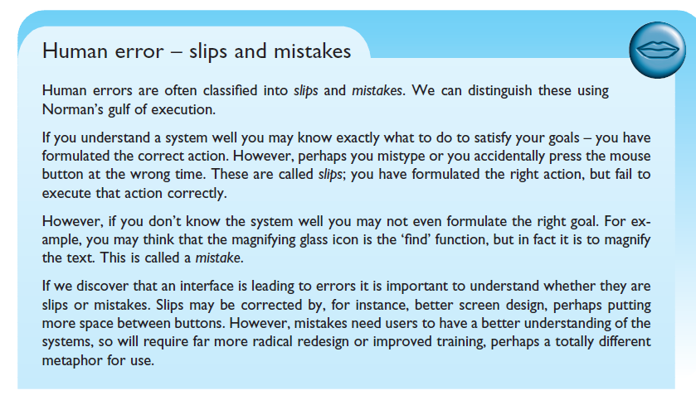
Human errors- Slips or Mistakes

Slide 21
Shortfalls of Norman’s model
Norman’s model is a useful means of understanding the interaction, in a way that is clear and intuitive. It allows other, more detailed, empirical and analytic work to be placed within a common framework.
However, it only considers the system as far as the interface. It concentrates wholly on the user’s view of the interaction.
It does not attempt to deal with the system’s communication through the interface.
An extension of Norman’s model, proposed by Abowd and Beale, addresses this problem

Slide 22
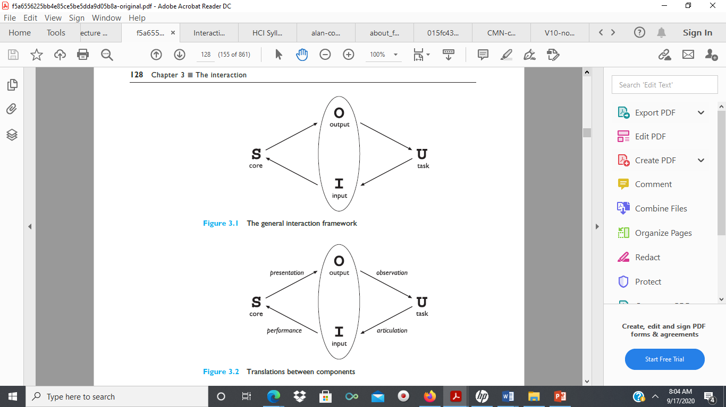
Abowd and Beale’s Interaction framework
The interaction framework attempts a more realistic description of interaction by including the system explicitly, and breaks it into four main components, as shown in Figure 2.
The nodes represent the four major components in an interactive system: the System, the User, the Input and the Output.
Each component has its own language.
Figure 2

Slide 23
Abowd and Beale’s Interaction framework
In addition to the User’s task language and the System’s core language, which we have already introduced, there are languages for both the Input and Output components.
Input and Output together form the Interface.
As the interface sits between the User and the System, there are four steps in the interactive cycle, each corresponding to a translation from one component to another, as shown by the labeled arcs in the Figure on this slide

Slide 24
Abowd and Beale’s Interaction framework
The User begins the interactive cycle with the formulation of a goal and a task to achieve that goal.
The only way the user can manipulate the machine is through the Input, and so the task must be articulated within the input language.

Slide 25
Abowd and Beale’s Interaction framework
The input language is translated into the core language as operations to be performed by the System.
The System then transforms itself as described by the operations; the execution phase of the cycle is complete and the evaluation phase now begins.
The System is in a new state, which must now be communicated to the User.

Slide 26
Abowd and Beale’s Interaction framework
The current values of system attributes are rendered as concepts or features of the Output.
It is then up to the User to observe the Output and assess the results of the interaction relative to the original goal, ending the evaluation phase and, hence, the interactive cycle.

Slide 27
Frameworks and HCI
As well as providing a means of discussing the details of a particular interaction, frameworks provide a basis for discussing other issues that relate to the interaction.
The ACM SIGCHI (The Association for Computing Machinery Special Interest Group on Computer-Human Interaction) Curriculum Development Group presents a framework similar to that presented on earlier slides, and uses it to place different areas that relate to HCI
In Figure 3 on the next slide shows how different aspects relate to the interaction framework

Slide 28
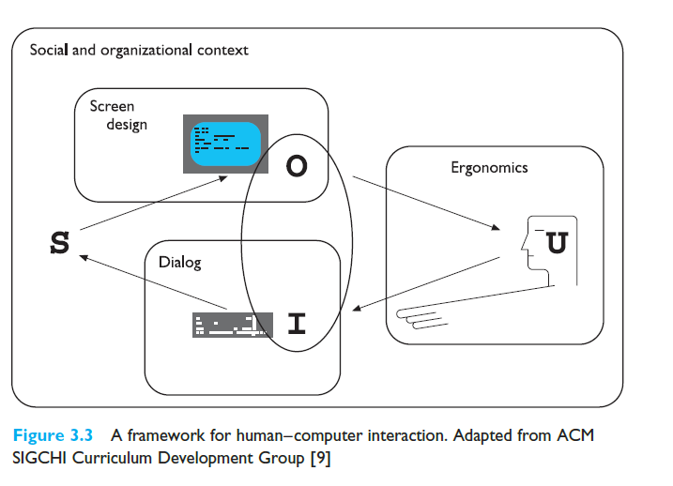
A framework for human–computer interaction. Adapted from ACM SIGCHI Curriculum Development Group
the field of ergonomics addresses issues on the user side of the interface, covering both input and output, as well as the user’s immediate context.
dialog is most usually associated with the computer and so is biased to that side of the framework.
Presentation and screen design relates to the output branch of the framework.
Each of these areas has important implications for the design of interactive systems and the performance of the user
Figure 3

Slide 29
ERGONOMICS
Ergonomics (or human factors) is traditionally the study of the physical characteristics of the interaction: how the controls are designed, the physical environment in which the interaction takes place, and the layout and physical qualities of the screen.
Ergonomics is a large and established field, which is closely related to but distinct from HCI, and full coverage would demand a course in its own right
However, let us consider some of the issues addressed by ergonomics relating to HCI
We will look at the arrangement of controls and displays, the physical environment, health issues and the use of color.

Slide 30
Ergonomics: Arrangement of controls and displays
Sets of controls and parts of the display should be grouped logically to allow rapid access by the user
This may not seem so important when we are considering a single user of a spreadsheet on a PC, but it becomes vital when we turn to safety-critical applications such as plant control, aviation and air traffic control.
In each of these contexts, users are under pressure and are faced with a huge range of displays and controls.
Therefore, it is crucial that the physical layout of these are appropriate.

Slide 31
Ergonomics: Arrangement of controls and displays
Even for less critical PC application, inappropriate placement of controls and displays can lead to inefficiency and frustration.
For example, on a particular electronic newsreader, the command key to read articles from a newsgroup (y) is directly beside the command key to unsubscribe from a newsgroup (u) on the keyboard.
This poor design frequently leads to inadvertent removal from newsgroups. Although this is recoverable it wastes time and is annoying to the user.
We can therefore see that appropriate layout is important in all applications.
It is important to group controls together logically (and keeping opposing controls separate).
Notes:
Newsgroup, Internet-based discussion group, similar to a bulletin board system (BBS), where people post messages concerning whatever topic around which the group is organized.

Slide 32
Ergonomics: Arrangement of controls and displays
The exact arrangement of controls will depend on the domain and the application, but possible arrangements include the following:
  functional controls and displays are organized so that those that are functionally related are placed together;
  sequential controls and displays are organized to reflect the order of their use in a typical interaction (this may be especially appropriate in domains where a particular task sequence is enforced, such as aviation);
  frequency controls and displays are organized according to how frequently they are used, with the most commonly used controls being the most easily accessible.

Slide 33
Ergonomics: Arrangement of controls and displays
In addition to the organization of the controls and displays in relation to each other, the entire system interface must be arranged appropriately in relation to the user’s position.
So, for example, the user should be able to reach all controls necessary and view all displays without excessive body movement.
Critical displays should be at eye level.
Lighting should be arranged to avoid glare and reflection, distorting displays.
Controls should be spaced to provide adequate room for the user to manoeuvre.

Slide 34
Ergonomics: The physical environment of the interaction
As well as addressing physical issues in the layout and arrangement of the machine interface, ergonomics is also concerned with the design of the work environment itself.
Where will the system be used? By whom will it be used? Will users be sitting, standing or moving about?
Again, this will depend largely on the domain and will be more critical in specific control and operational settings than in general computer use.
However, the physical environment in which the system is used may influence how well it is accepted and even the health and safety of its users.
It should therefore be considered in all designs.

Slide 35
Ergonomics: The physical environment of the interaction
The first consideration here is the size of the users. Obviously this is going to vary considerably.
However, in any system the smallest user should be able to reach all the controls (this may include a user in a wheelchair), and the largest user should not be cramped in the environment.
In particular, all users should be comfortably able to see critical displays. For long periods of use, the user should be seated for comfort and stability.
Seating should provide back support.
If required to stand, the user should have room to move around in order to reach all the controls.

Slide 36
Ergonomics: The physical environment of the interaction
bear in mind the possible consequences of our designs on the health and safety of users.
obvious safety risks of poorly designed safety-critical systems(aircraft crashing, nuclear plant leaks and worse),
there are a number of factors that may affect the use of more general computers.
      Physical position
      Temperature
      Lighting
      Noise
      Time

Slide 37
Ergonomics: The use of colour
the use of colour in displays is an ergonomics issue.
Colours used in the display should be as distinct as possible and the distinction should not be affected by changes in contrast.
Blue should not be used to display critical information.

Slide 38
Ergonomics: The use of colour
The colors used should also correspond to common conventions and user expectations.
Red, green and yellow are colors frequently associated with stop, go and standby respectively.
  Therefore, red may be used to indicate emergency and alarms;
  green, normal activity; and
  yellow, standby and auxiliary function.
These conventions should not be violated without very good cause.

Slide 39
Ergonomics: The use of colour
However, colour conventions are culturally determined.
For example, red is associated with danger and warnings in most western cultures, but in China it symbolizes happiness and good fortune.
The colour of mourning is black in some cultures and white in others.
Awareness of the cultural associations of colour is particularly important in designing systems and websites for a global market.

Slide 40
Interaction styles
Interaction can be seen as a dialog between the computer and the user.
The choice of interface style can affect the interaction in positive or negative ways.

Slide 41
Interaction styles
There are a number interface styles including:
    command line interface
    menus
    natural language
    question/answer and query dialog
    form-fills and spreadsheets
    WIMP
    point and click
    three-dimensional interfaces.

Slide 42
Command Line Interface
The command line interface was the first interactive dialog style to be commonly used and, in spite of the availability of menu-driven interfaces, it is still widely used.
It provides a means of expressing instructions to the computer directly, using function keys, single characters, abbreviations or whole-word commands.
More commonly today, it is supplementary to menu-based interfaces, providing accelerated access to the system’s functionality for experienced users.

Slide 43
Command Line Interface (Pros)
Command line interfaces are powerful in that they offer direct access to system functionality (as opposed to the hierarchical nature of menus)
They are also flexible: the command often has a number of options or parameters that will vary its behavior in some way, and it can be applied to many objects at once, making it useful for repetitive tasks
Read more on the advantages of command line interface

Slide 44
Command Line Interface (Cons)
Commands must be remembered, as no cue is provided in the command line to indicate which command is needed.
They are therefore better for expert users than for novices.
commands are sometimes obscure and vary across systems, causing confusion to the user and increasing the overhead of learning.
Read more on the disadvantages of command line interface

Slide 45
Menus
In a menu-driven interface, the set of options available to the user is displayed on the screen, and selected using the mouse, or numeric or alphabetic keys.
Since the options are visible they are less demanding of the user, relying on recognition rather than recall.
However, menu options still need to be meaningful and logically grouped to aid recognition.
naming of menu options cues for the user to find the required option.
Such systems either can be purely text based, or may have a graphical component

Slide 46
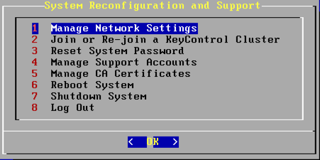
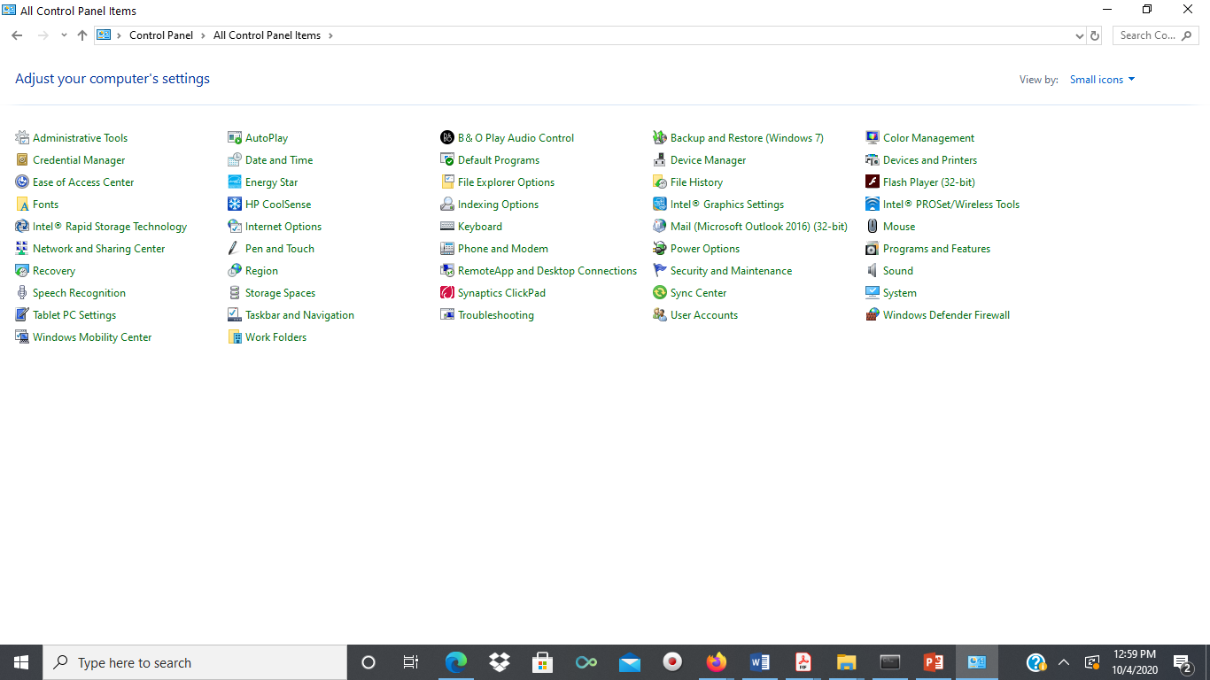
Text-based vs graphics-based menus
With text-based menus, with the menu options are presented as numbered choices
With Graphics-based menus, menus appears within a rectangular box and choices are made, perhaps by typing the initial letter of the desired selection, or by entering the associated number, or by moving around the menu with the arrow keys or mouse.
Example of text-based menu

Slide 47
Natural Language
Perhaps the most attractive means of communicating with computers, at least at first glance, is by natural language.
Users, unable to remember a command or lost in a hierarchy of menus, may long for the computer that is able to understand instructions expressed in everyday words!
Natural language understanding, both of speech and written input, is the subject of much interest and research currently.
Unfortunately, however, the ambiguity of natural language makes it very difficult for a machine to understand.

Slide 48
The ambiguity of natural language
Eg. Consider the sentence: The boy hit the dog with the stick
we cannot be sure whether the boy is using the stick to hit the dog or whether the dog is holding the stick when it is hit.
Even if a sentence’s structure is clear, we may find ambiguity in the meaning of the words used.
For example, the word ‘pitch’ may refer to a sports field, a throw, a waterproofing substance or even, colloquially, a territory.

Slide 49
The ambiguity of natural language
We often rely on the context and our general knowledge to sort out these ambiguities. This information is difficult to provide to the machine.
Given these problems, it seems unlikely that a general natural language interface will be available for some time.
However, systems can be built to understand restricted subsets of a language.
For a known and constrained domain, the system can be provided with sufficient information to disambiguate terms.
It is important in interfaces which use natural language in this restricted form that the user is aware of the limitations of the system and does not expect too much understanding.

Slide 50
Question/answer and query dialog
Question and answer dialog is a simple mechanism for providing input to an application in a specific domain.
The user is asked a series of questions (mainly with yes/no responses, multiple choice, or codes) and so is led through the interaction step by step.
An example of this would be web questionnaires.
These interfaces are easy to learn and use, but are limited in functionality and power.
As such, they are appropriate for restricted domains (particularly information systems) and for novice or casual users.

Slide 51
Question/answer and query dialog
Query languages, on the other hand, are used to construct queries to retrieve information from a database.
They use natural-language-style phrases, but in fact require specific syntax, as well as knowledge of the database structure.
Queries usually require the user to specify an attribute or attributes for which to search
the database, as well as the attributes of interest to be displayed.
This is straightforward where there is a single attribute, but becomes complex when multiple attributes are involved

Slide 52
Form-fills and spreadsheets
Form-filling interfaces are used primarily for data entry but can also be useful in data retrieval applications.
The user is presented with a display resembling a paper form, with slots to fill in.
Often the form display is based upon an actual form with which the user is familiar, which makes the interface easier to use.
The user works through the form, filling in appropriate values.
The data is then entered into the application in the correct place.

Slide 53
Form-fills and spreadsheets
Spreadsheets are a sophisticated variation of form filling.
The spreadsheet comprises a grid of cells, each of which can contain a value or a formula.
The formula can involve the values of other cells

Slide 54
The WIMP interface
Currently many common environments for interactive computing are examples of the WIMP interface style, often simply called windowing systems.
WIMP stands for windows, icons, menus and pointers (sometimes windows, icons, mice and pull-down menus), and is the default interface style for the majority of interactive computer systems in use today, especially in the PC and desktop workstation arena.
Examples of WIMP interfaces include Microsoft Windows, MacOS and many other software interfaces

Slide 55
Point-and-click interfaces
In most multimedia systems and in web browsers, virtually all actions take only a single click of the mouse button.
  You may point at a city on a map and when you click a window opens, showing you tourist information about the city.
  You may point at a word in some text and when you click you see a definition of the word. You may point at a recognizable iconic button and when you click some action is performed.
This point-and-click interface style is obviously closely related to the WIMP style.

Slide 56
Point-and-click interfaces
It clearly overlaps in the use of buttons, but may also include other WIMP elements.
However, the philosophy is simpler and more closely tied to ideas of hypertext.
In addition, the point-and-click style is not tied to mouse-based interfaces, and is also extensively used in touchscreen information systems.
The point-and-click style has been popularized by world wide web pages, which incorporate all the above types of point-and-click navigation: highlighted words, maps and iconic buttons.

Slide 57
Three-dimensional interfaces
There is an increasing use of three-dimensional effects in user interfaces.
The most obvious example is virtual reality, but VR is only part of a range of 3D techniques available to the interface designer.
The simplest technique is where ordinary WIMP elements, buttons, scroll bars, etc., are given a 3D appearance using shading, giving the appearance of being sculpted out of stone.

Slide 58
Summary
Interaction models help us to understand what is going on in the interaction between user and system. They address the translations between what the user wants and what the system does.
Ergonomics looks at the physical characteristics of the interaction and how these influence its effectiveness.
The dialog between user and system is influenced by the style of the interface.
The interaction takes place within a social and organizational context that affects both user and
system.

Slide 59
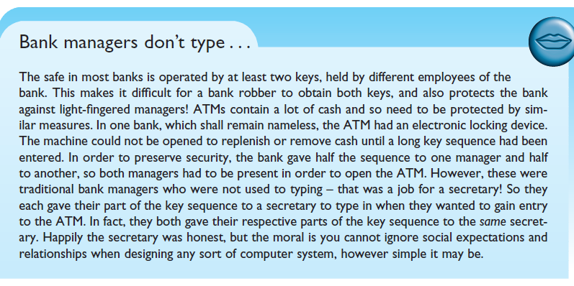

Slide 60
THANK YOU

